Slide 1
Insurance Analytics Dashboard & Business Insights
Group 3
Akhil Anil
Vishal Prasad
Madhu Kumari
Nikhil Krishna
Kasina Sasi Naga Sai
Prem Kumar

Slide 2
Business Requirements & KPIs
Business Requirements:
- Track premium revenue
- Analyze claim amount & frequency
- Evaluate policy performance
- Identify profitable customers
Key KPIs:
- Total Premium
- Total Claims
- Claim Ratio
- Policy Performance

Slide 3
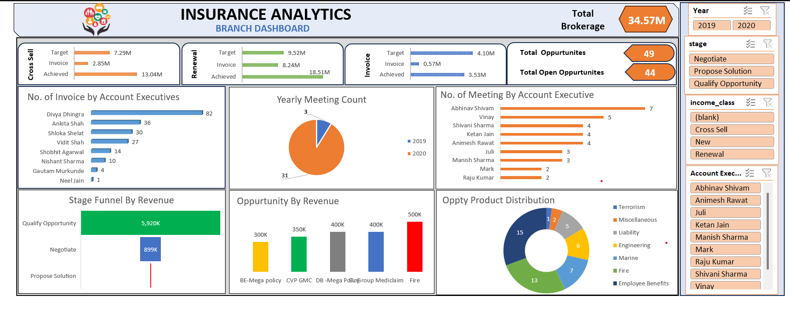
Excel Dashboard Overview
Shows summary of premium, claims, and customer distribution.
Used for quick reporting and KPI tracking

Slide 4
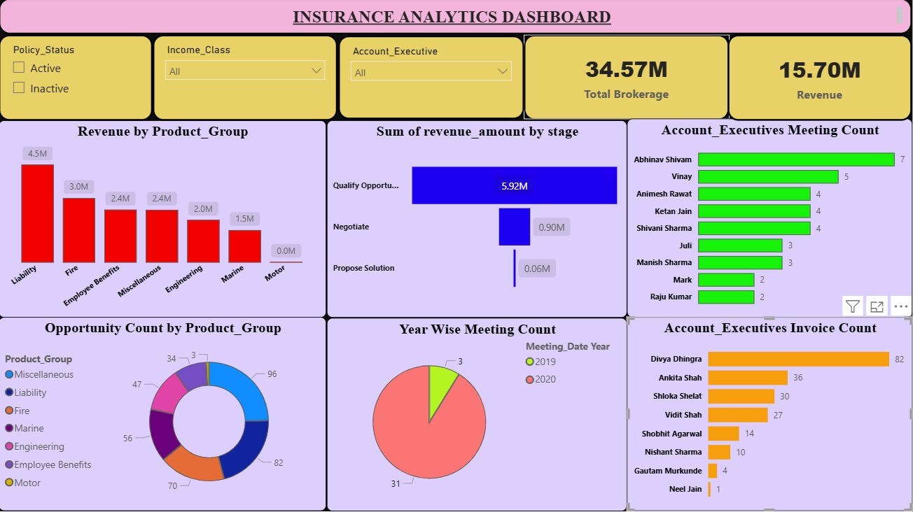
Power BI Dashboard Overview
Interactive KPIs, trend analysis, and drill-down insights.
Helps in deeper business analysis.

Slide 5
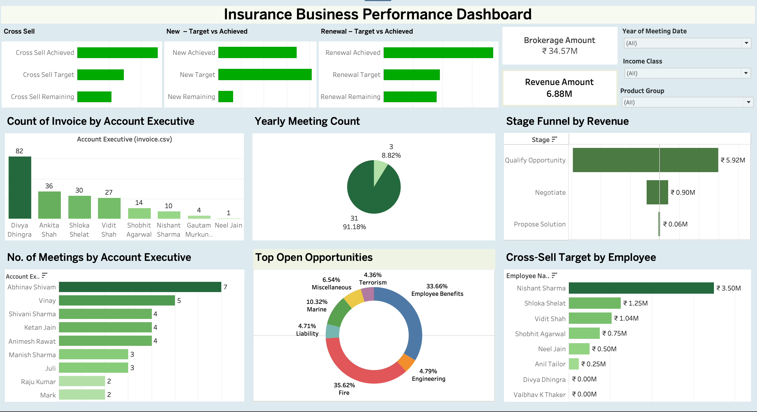
Tableau Dashboard Overview
Visual storytelling and comparative analysis of policies and claims.

Slide 6
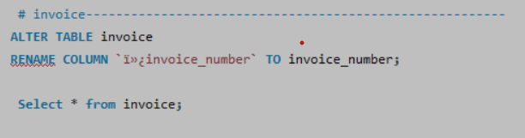
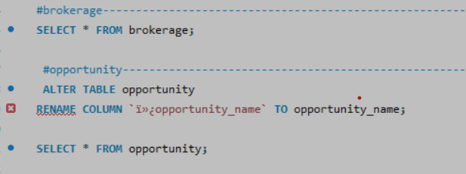
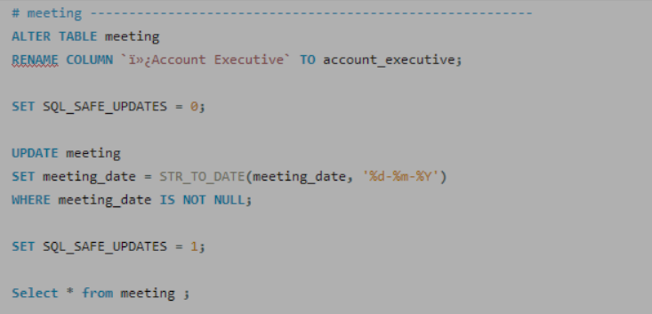
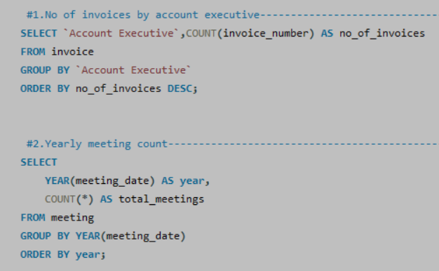
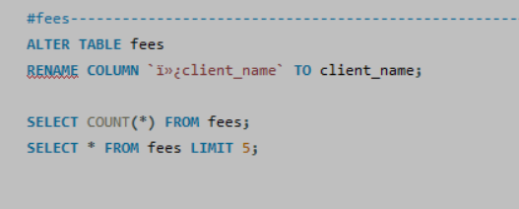
SQL Overview

Slide 7
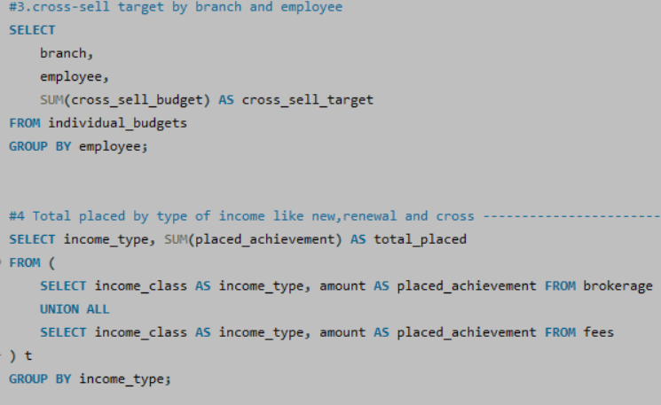
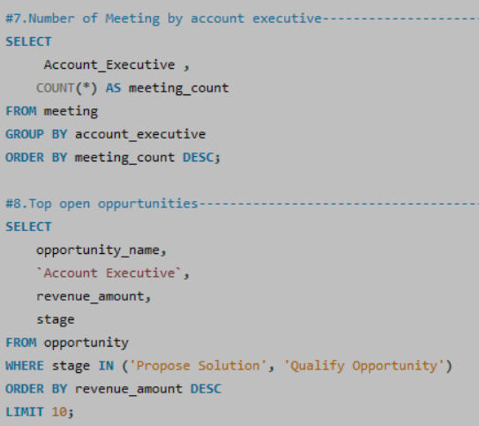
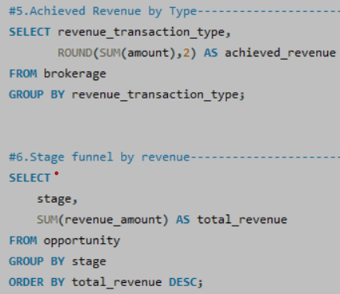

Slide 8
KPI Conclusions & Suggestions
Conclusions:
- Few policies generate maximum revenue
- High claim ratio indicates risky policies
Suggestions:
- Focus on high-performing policies
- Optimize high-claim policies

Slide 9
Business Impact & Final Conclusion
Business Impact:
- Better data-driven decisions
- Reduced risk and improved profitability
Final Conclusion:
Dashboards convert raw data into meaningful business insights.

